Slide 1

Data Link Layer

Slide 2
Data Link Layer Design Issues
Services Provided to the Network Layer
Framing
Error Control
Flow Control

Slide 3
Functions of the Data Link Layer
Provide service interface to the network layer
Dealing with transmission errors
Regulating data flow
  Slow receivers not swamped by fast senders

Slide 4
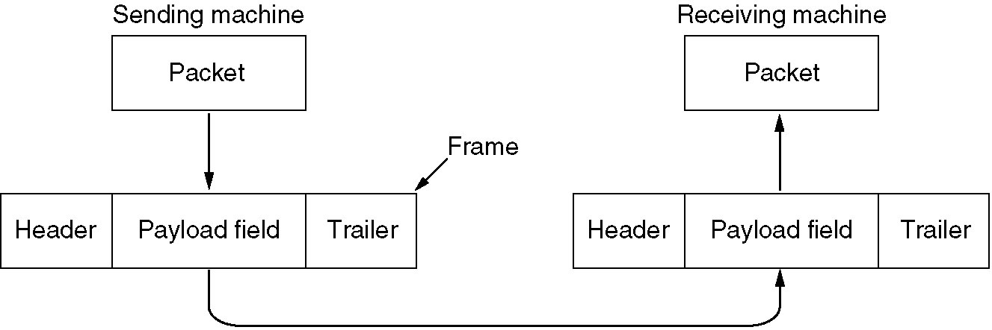
Functions of the Data Link Layer (2)
Relationship between packets and frames.

Slide 5
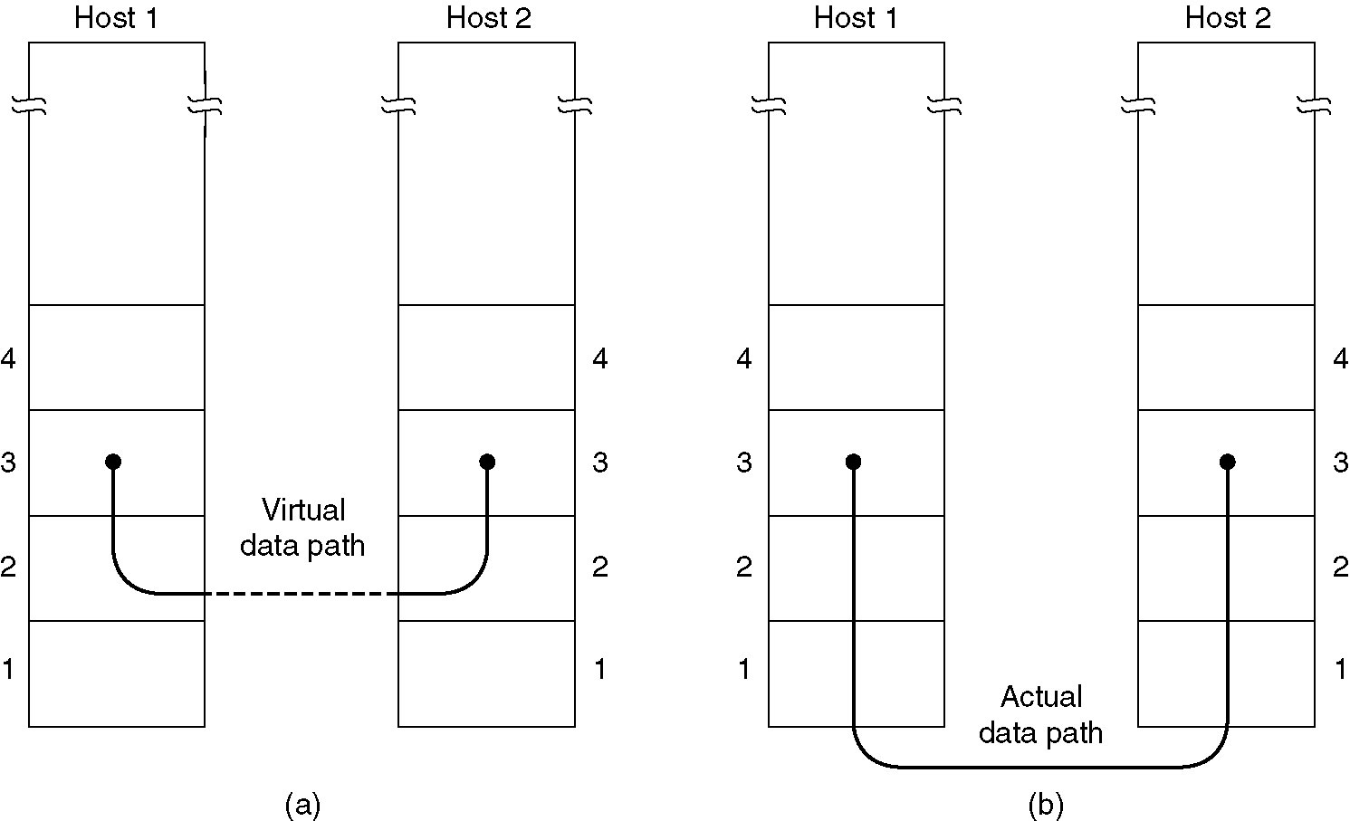
Services Provided to Network Layer
(a) Virtual communication.
(b) Actual communication.

Slide 6
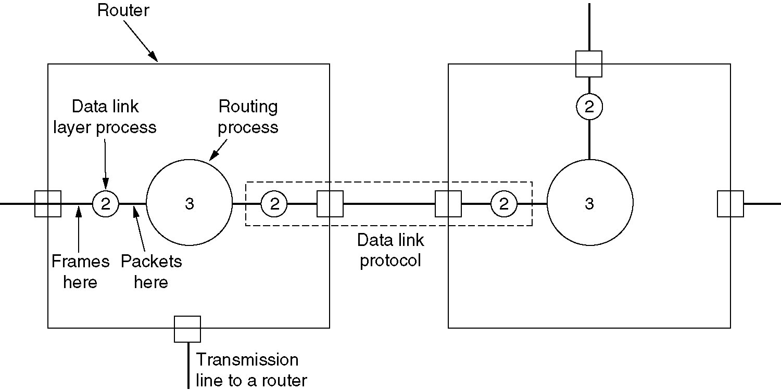
Placement of DLL
Placement of the data link protocol.

Slide 7
Types of services provided to the Network Layer
Unacknowledged Connectionless service
Acknowledged Connectionless service
Acknowledged Connection-Oriented service

Slide 8
Unacknowledged Connectionless service
Losses are taken care of at higher layers
Used on reliable medium like coax cables or optical fiber, where the error rate is low.
Appropriate for voice, where delay is worse than bad data.

Slide 9
Acknowledged Connectionless service
Useful on unreliable medium like wireless.
Acknowledgements add delays.
Adding ack in the DLL rather than in the NL is just an optimization and not a requirement. Leaving it for the NL is inefficient as a large message (packet) has to be resent in that case in contrast to small frames here.
On reliable channels, like fiber, the overhead associated with the ack is not justified.

Slide 10
Acknowledged Connection-oriented service
Most reliable,
Guaranteed service –
  Each frame sent is indeed received
  Each frame is received exactly once
  Frames are received in order
Special care has to be taken to ensure this in connectionless services

Slide 11
Framing
Character Count
Flag bytes with byte stuffing
Flag bytes with bit stuffing

Slide 12
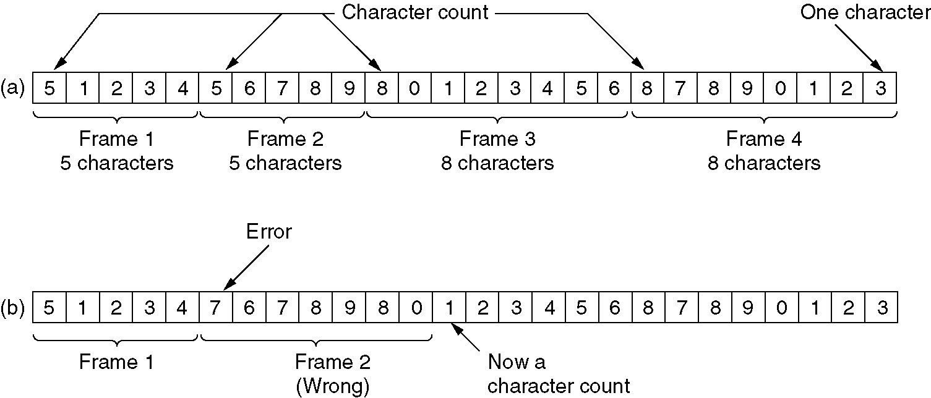
Framing with Character Count
A character stream. (a) Without errors. (b) With one error.

Slide 13
Problem with Framing with CC
What if the count is garbled
Even if with checksum, the receiver knows that the frame is bad there is no way to tell where the next frame starts.
Asking for retransmission doesn’t help either because the start of the retransmitted frame is not known
No longer used

Slide 14
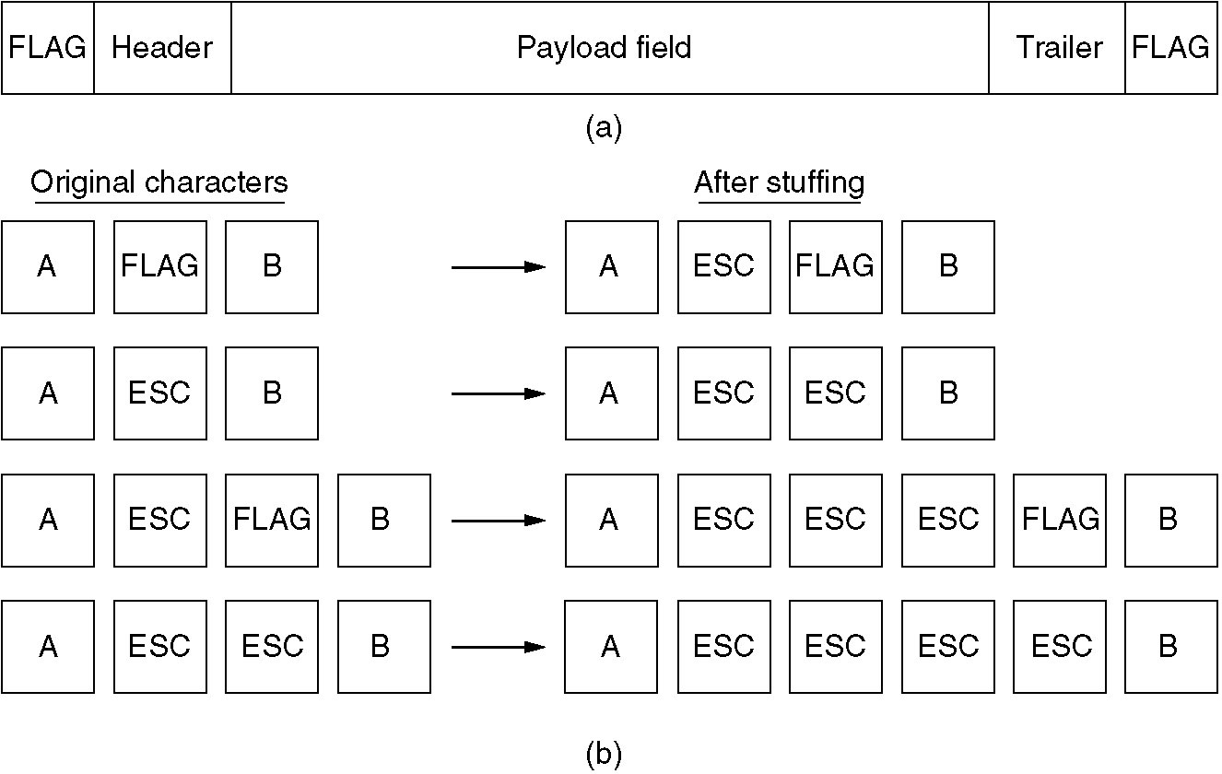
Framing with byte stuffing

Slide 15
Framing with byte stuffing
Problem : fixed character size : assumes character size to be 8 bits : can’t handle heterogeneous environment.

Slide 16
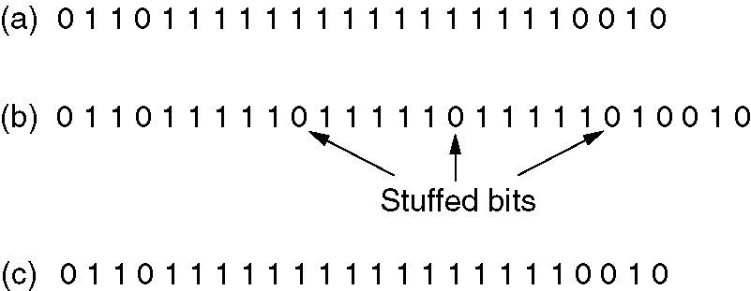
Framing with bit stuffing
Bit stuffing
(a) The original data.
(b) The data as they appear on the line.
(c) The data as they are stored in receiver’s memory after destuffing.

Slide 17
Error Control
Positive and Negative feedback
Timers : what happens when a frame completely vanishes : receiver neither sends a +ack nor –ack … then timer comes to help.
  It may result in a frame being sent more than once and received more than once :
  solution : assign sequence numbers to frames

Slide 18
Error Detection and Correction
In some cases it is sufficient to detect an error and in some, it requires the errors to be corrected also. For eg.
  On a reliable medium : ED is sufficient where the error rate is low and asking for retransmission after ED would work efficiently
  In contrast, on an unreliable medium : Retransmission after ED may result in another error and still another and so on. Hence EC is desirable.

Slide 19
Hamming Codes : for ED n EC
m data bits together with r error check bits form an n = (m + r) bit codeword
The number of bits two codewords differ in is called the hamming distance between the two codewords
Significance : If two codewords are at HD d then it requires d single bit errors to convert one into the other

Slide 20
HD of a coding scheme
For m bit data .. All the 2^m possible combinations are legal
But not all the 2^n codewords are used
-- in a coding scheme (algorithm to compute the check bits) some of these codewords are legal and others are illegal
For eq .. Consider parity : 1(r = 1) parity bit is appended with value so that the total number of 1’s in the codeword is even ..
Then 11011 is a legal codeword in this scheme but 11010 is not

Slide 21
HD of a list of legal codewords
Minimum HD between any pair of legal codewords in the list
Remember : Each algorithm to compute the check bits create a different list of legal codewords

Slide 22
Use of HD for error detection
To detect d single bit errors , we need (an algorithm that creates) a code list with HD at least d + 1
For eg . For the parity scheme .. HD is 2 ..hence it can be used to detect single bit errors (d=1)

Slide 23
Continued…
If the recvd codeword is legal .. We accept it ,
And if it is illegal we report (detect) an error
Q1 : Can it happen that we recv a legal codeword when d single bit errors have ocurred …this is eqwt to saying can we get a legal code from another legal code by d single bit errors?
A1 : No, since the HD of the code is at least d + 1. So a legal CW can be genearted from another LCW by inerting at least d + 1 bits and not by inverting d or less bits.

Slide 24
Continued…
Q2 : Can we get an illegal CW when no error has occurred ?
A2 : Obviously not ..since the legal CW was sent by the sender and if no error has occurred then the recver must recv a legal CW

Slide 25
Use of HD for error correction
To correct d single bit errors , we need (an algorithm that creates) a code list with HD at least 2d + 1.
For eg. Consider the following legal CWs:
0000000000, 0000011111,1111100000,1111111111
HD is 5 .. It can be used to correct 2 single bit errors

Slide 26
Continued..
Claim : Suppose we recv an illegal code C .. Then there is a unique legal code which is at a distance d or less from C
Proof : Suppose there are 2 codes C1 and C2 at distance d (or less) from C .. Then C1 can be obtained from C2 by 2d (or less) inversions .. A contradiction to (code has HD at least 2d + 1)

Slide 27
Continue…
Obtain C1 from C2
Lets rearrange the bits of C so that all the bits(B1) that are inverted to obtain C1 are in the beginning followed by bits(B2) inverted to obtain C2 ..followed by the remaining bits (B3) ..In the worst case there is no overlapping between B1 and B2 .. In that case C1 is obtained from C2 by inverting exactly these B1 and B2 bits which together are no more than 2d .. (if there is some overlapping then those bits are not inverted, hence < 2d)

Slide 28
Hamming Code to correct one bit errors
The bits of the CW are numbered left to right , starting from 1 … the bits that are powers of 2 are check bits (1,2,4,8 …) and the remaining are data bits.
Expand the position of each data bit in powers of 2 ..for eg. 11 = 1 + 2 + 8 .. So 11th bit contributes to the computation of value of these check bits I.e. 1,2, 8

Slide 29
Continued…
We do this for each data bit ..
The value of a check bit is computed so that the parity of the all the data bits that contribute to it together with the check bit itself is even.
For eg .
data bits 1001000 will be sent as the codeword 00110010000

Slide 30
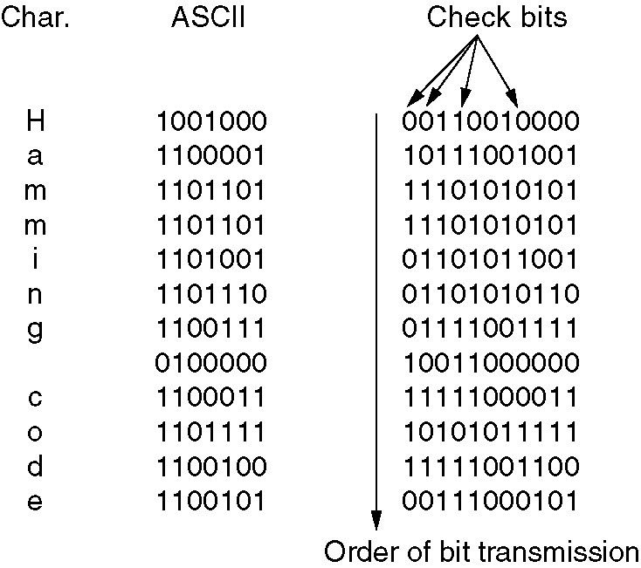
Hamming Code to correct burst errors

Slide 31
Error detecting code
Polynomial code or CRC( Cyclic Redundancy Check )

Slide 32
CRC
A message m : a string of bits corresponds to a polynomial denote it by M(x).
r check bits ….polynomial R(x).
Transmitted bits m + r ….polynomial
T(x) = M(x) + R(x)
Generator polynomial G(x)
r checkbits are computed so that when G(x) divides T(x), the remainder is zero.

Slide 33
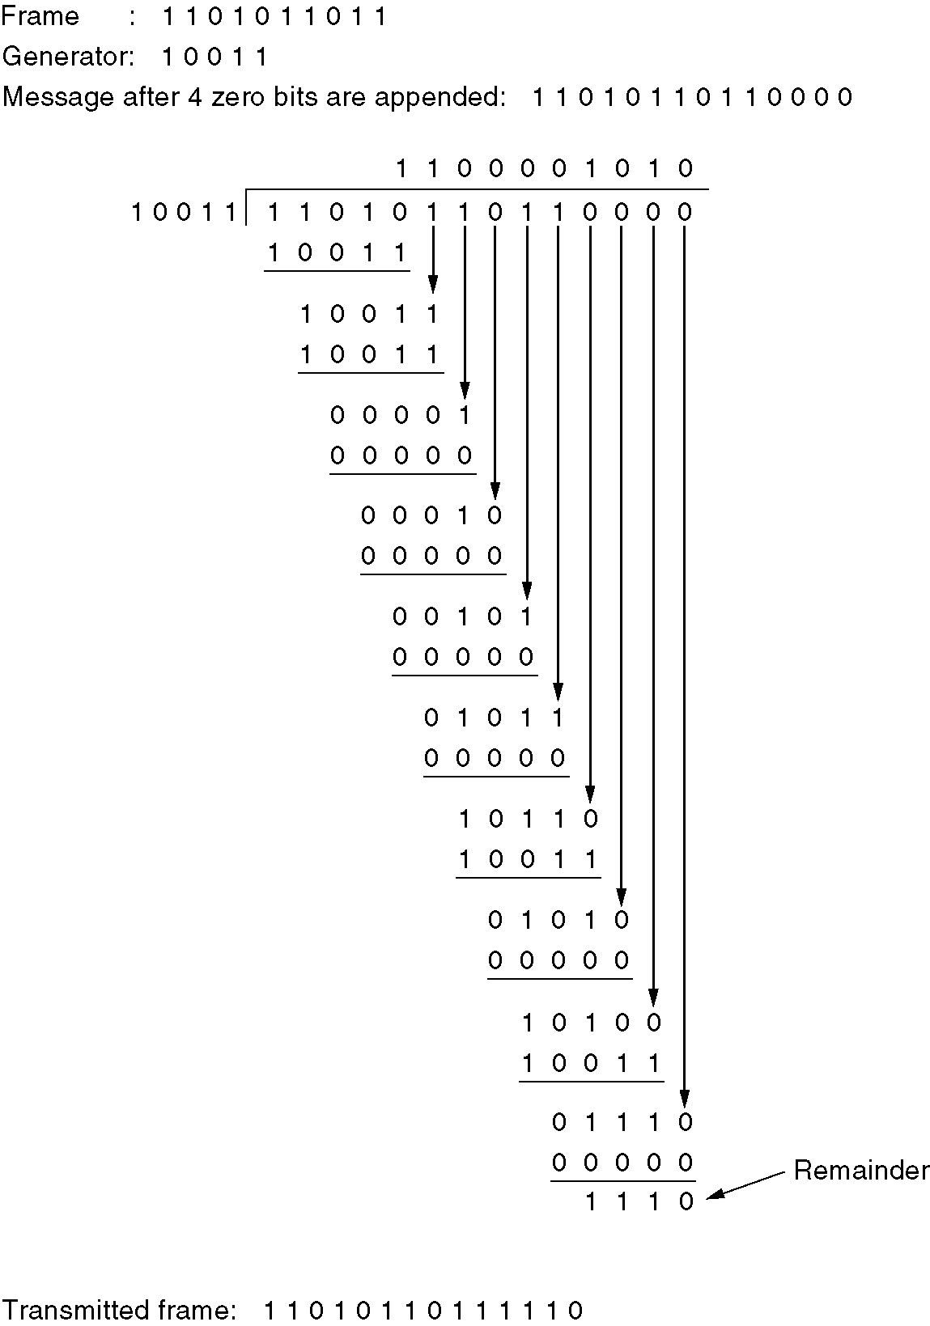
Error-Detecting Codes
Calculation of the polynomial
code checksum.

Slide 34
CRC contd..
At the receiving end, receiver again divides the polynomial corresponding to the received bits by G(x) and accepts it iff the remainder is zero.
Now let E(x) denote the polynomial corresponding to the errored bits. Then receiver receives
T’(x) = T(x) + E(x)
G(x) divides T’(x) iff it divides E(x)

Slide 35
CRC
Detecting single bit errors
E(x) = x^i
Choose G(x) = any polynomial with at least two terms

Slide 36
Detecting 2 single bit errors
E(x) = x^i + x^j = x^i (x ^ (j-i) + 1)
Choose G(x) s.t it neither divides x nor divides x^k + 1 for any k <= frame length

Slide 37
Detecting odd number of single bit errors
E(x) can’t be of the form (x + 1) Q(x)
Choose G(x) of the type (x + 1) Q(x)

Slide 38
G(x) = a general polyn of degree r
Will detect single burst of length <= r
Will accept (without detecting) bursts of length r+1 with probably only ½^(r-1)
Will accept longer bursts (without detecting) with probability only ½^r
Note : Certain Polynomials have become international standards

Slide 39
Detecting single burst of length k <=r with a gen polyn of degree r
E(x) = x^i ( x^(k-1) + …+ 1)
Choose G(x) = Q(x) + 1
If k-1 < degree of G(x) then G(x) can never divide E(x) … I.e. if k-1 < r ..I.e. if k <= r

Slide 40
IEEE 802 LANs use
For eg.
X^32 + x^26 + x^23 + x^22 …..x^2 + x + 1
Detects single burst of length <= 32
Note : A simple shift register circuit can be constructed to compute and verify the checksums in hardware.

Slide 41
I Acknowledge
Help from the following site
http://www.cs.vu.nl/~ast/
In preparing this lecture.

